Slide 1
SQL Server Availability Groups
And Distributed AGs

Slide 2
What Are Availability Groups?

Slide 3
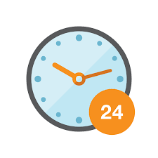
What is AG
Form of High Availability (H/A)
Newer alternative to DB mirroring and log shipping
SQL2012+
Supports failovers
All DBs within AG failover at the same time
Can be used for read-scale
Can be used for DR
*Can run across different domains (Distributed AG)

Slide 4

AG Terminlogy
Availability Group (AG)
A container that groups a set of databases together, that will failover together
Availability Database
A DB that belongs to an AG
1 primary and up to 8 secondary copies of each AG DB
Primary Database
The only read-write copy
Secondary Database
Read-only (or non-readable) copy
Changes are synced from primary to all secondary copies

Slide 5

AG Terminlogy, cont’d
Availability Replica
A ‘node’ within the AG that is hosted on a standalone sql instance with a WSFC
Maintains a local copy of each AG database
Primary Replica
Contains the primary (read-write) AG databases
Sends transaction log records to each secondary replica
Secondary Replica
Contains the secondary (read-only or non-readable) copies of the AG databases
Can be failover target
Can support read-only access (e.g. to spread read loads such as reporting, do backups)
Listener
A server name to which clients can connect - has a DNS entry
Directs traffic to appropriate replica depending on connection ‘intent’ (read vs write)

Slide 6

AG Features
2 - 9 availability replicas
1 primary, 1-8 secondary
Synchronous vs asynchronous commit mode
Multiple DBs per AG
Fail over together
Primary = read/write Secondary = read-only or non-readable
Data synchronisation between primary and secondaries

Slide 7
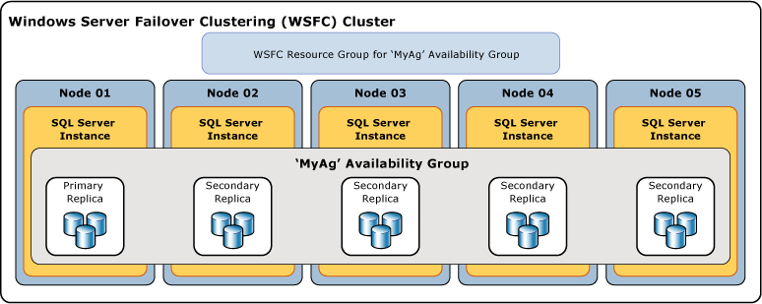
AG Requirements
Built on *Windows Server Failover Cluster (WSFC)

Slide 8

AG Requirements, cont’d
Each replica on different node in WSFC
One or more DBs within AG
1 or more AG per sql instance / cluster
AG Name must be unique in WSFC (resource)
SQL Server 2012+
Enterprise Edition (also works in developer for non-production)
*Up to 5 sync replicas
*No enforced max AGs and AG DBs per computer
Hardware dependent

Slide 9

AG Do’s and Don’ts
DO
Use TSQL / SSMS to perform failovers
DON’T
Perform failovers using WSFC
Change AG configuration (e.g. possible owners) via WSFC

Slide 10
Types of Failover
Automatic | Manual
Requires sync commit on primary and at least 1 secondary | No data loss provided primary and secondary in sync commit, and healthy ‘synchronized’ status
Requires secondary to by ‘synchronized’ and healthy | Triggered manually via tsql or SSMS
Requires ‘automatic’ failover mode | If async commit, failover is ‘forced’ and could potentially result in data loss.
Happens automatically when primary becomes unavailable (planned or unplanned) | Force failover is the only option for async secondaries (e.g. DR)

Slide 11
Availability Mode
Synchronous | Asynchronous
High availability | DR solution
Transaction must first harden on secondary before primary log is written and transaction commits | Primary does not wait for secondary to harden, could be some latency (network dependent)
Manual and automatic failover supported | Manual failover only
DBs should always be ‘synchronized’ | DBs will be ‘synchronizing’
Guaranteed that data will be fully in sync | Secondary data could be slightly behind

Slide 12

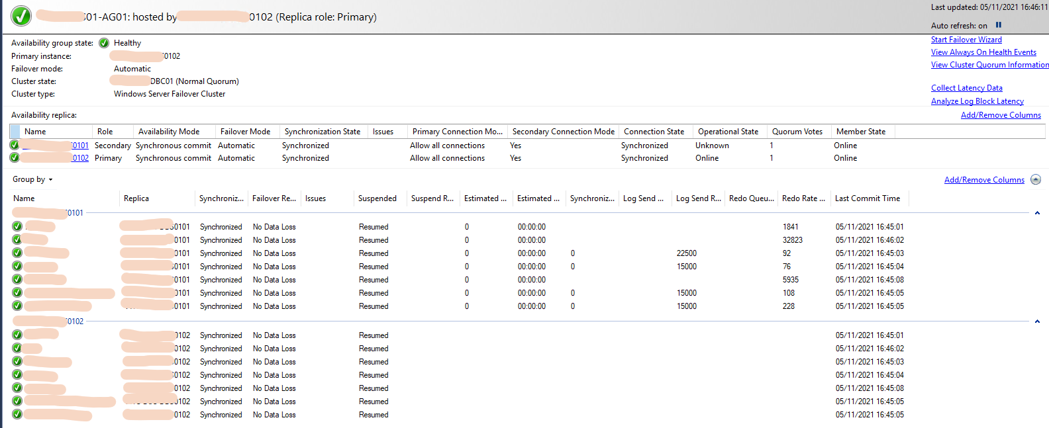
Monitoring AGs - Dashboard

Slide 13

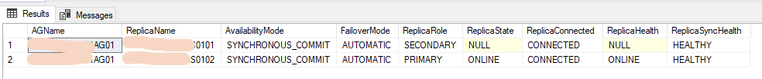
Monitoring AGs - TSQL (AG)
USE master
SELECT g.name AS AGName, r.replica_server_name AS ReplicaName, r.availability_mode_desc AS AvailabilityMode,
r.failover_mode_desc AS FailoverMode, ars.role_desc AS ReplicaRole, ars.operational_state_desc AS ReplicaState,
ars.connected_state_desc AS ReplicaConnected, ars.recovery_health_desc AS ReplicaHealth,
ars.synchronization_health_desc AS ReplicaSyncHealth
FROM sys.availability_groups g
JOIN sys.availability_replicas r ON r.group_id = g.group_id
JOIN sys.dm_hadr_availability_replica_states ars ON ars.group_id = r.group_id AND ars.replica_id = r.replica_id
WHERE g.is_distributed = 0

Slide 14
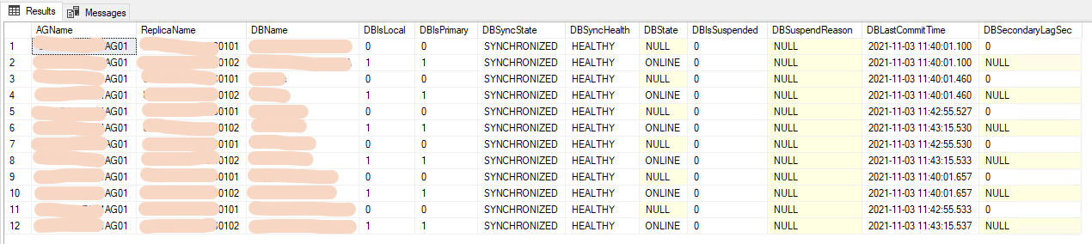
Monitoring AGs - TSQL (Database)
USE master
SELECT g.name AS AGName, r.replica_server_name AS ReplicaName, DB_NAME(drs.database_id) AS DBName, drs.is_local AS DBIsLocal,
drs.is_primary_replica AS DBIsPrimary, drs.synchronization_state_desc AS DBSyncState,
drs.synchronization_health_desc AS DBSyncHealth, drs.database_state_desc AS DBState,
drs.is_suspended AS DBIsSuspended, drs.suspend_reason_desc AS DBSuspendReason,
drs.last_commit_time AS DBLastCommitTime, drs.secondary_lag_seconds AS DBSecondaryLagSec
FROM sys.availability_groups g
JOIN sys.availability_replicas r ON r.group_id = g.group_id
JOIN sys.dm_hadr_database_replica_states drs ON drs.group_id = r.group_id AND drs.replica_id = r.replica_id
WHERE g.is_distributed = 0

Slide 15
Distributed Availability Groups

Slide 16
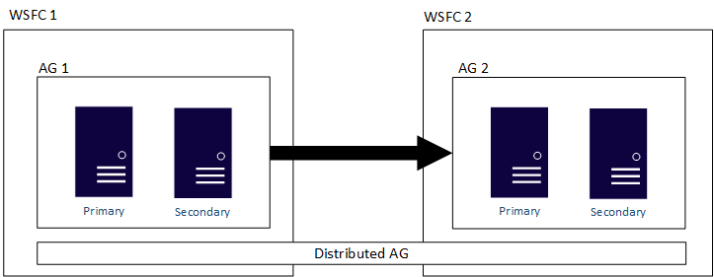
What is a Distributed AG?
SQL2016+
Does not utilise WSFC
SQLServer-Only construct
Can be cross-domain
Can be cross-platform (Windows/Linux, on-prem/Cloud, etc)
Can also be different major versions of Windows Server
‘Replicas’ for a DistAG are the Listeners of participating AGs
AG over AGs (rather than standalone SQL Server instances)

Slide 17
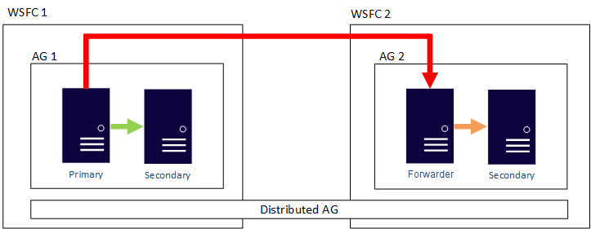
Data Movement in DistAG
Sync or Async (like normal AG)
Only 1 of DistAG DBs can be read/write => Global Primary
‘Secondary’ AG primary => R/O or R/W => Forwarder

Slide 18
Data Movement in DistAG, cont’d
Can be failed over like normal AG
Member AGs can be failed over locally
DistAG failover is forced-manual
Must include ALLOW_DATA_LOSS
SQL2017+ can mix major SQL versions within DistAG
GlobalPrimary must be same version or lower than other AGs
Can’t use SQL2012/2014

Slide 19
DistAGs Scenarios
Migration (e.g. from on-prem to cloud)
Load spreading (read loads - only 1 writable instance)
For readable forwarders, underlying AGs must have readable secondaries
Disaster Recovery
Upgrade major version
If Global Primary version lower than Forwarder, Forwarder is non-readable
Data flows but Forward will show ‘partially healthy’
Forwarder’s secondaries’ DBs will show Synchronizing/In Recovery
Can only failover to higher version, cannot failback to lower
After failover to higher, no more updates replicated to lower version
Can upgrade lower version to restore sync and allow failover

Slide 20
DistAGs Scenarios, cont’d
DistAGs can be chained!
Forwarder for DistAG1 can be Primary for DistAG2, etc
Read-only routing
Configure and works on primary
Configure but does not work on secondary
Will start working after failover when it becomes primary

Slide 21
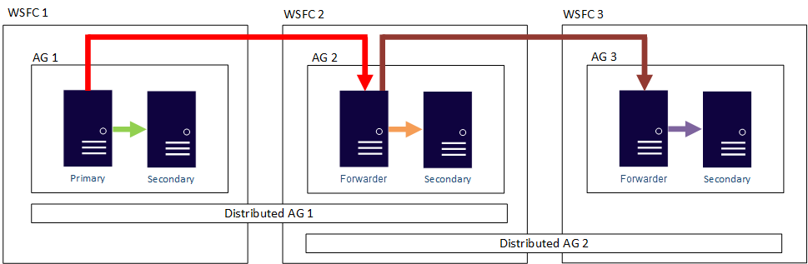
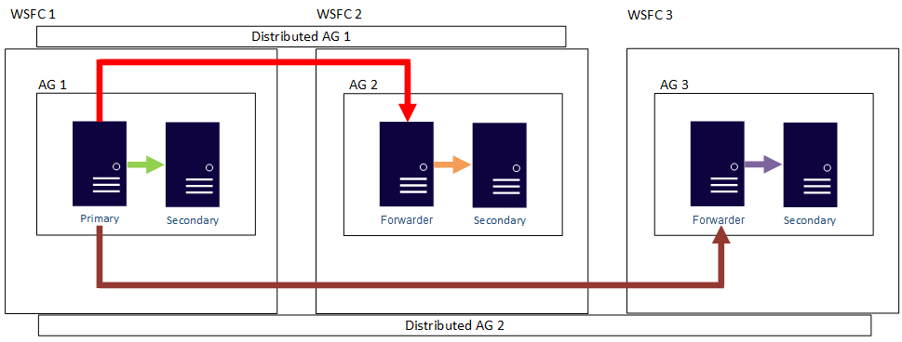

Slide 22
Permissions for DistAGs
Nothing special required when in same domain
Cross-domain requires certificates
Primaries in each underlying AG must have each other’s certs
It works to have the same cert on all nodes
Include secondaries to cater for local AG failovers
Certs can be signed with a master key
Export the master key and import to all other nodes that will use that cert

Slide 23
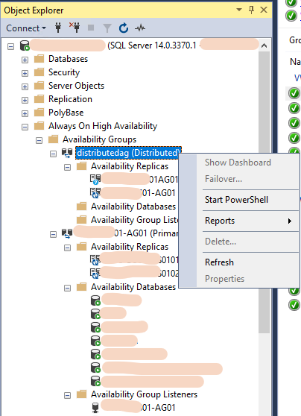
Monitoring DistAG - Dashboard
Distributed AGs (at this point) cannot be monitored via SSMS AG Dashboard (SQL2017, SSMS 18)
I don’t know if this will become a feature in the future?

Slide 24
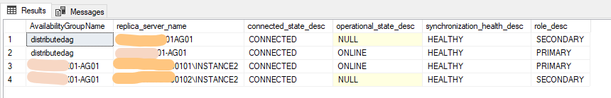
Monitoring DistAG - TSQL - Overview
--Status
SELECT g.name AS AvailabilityGroupName, rr.replica_server_name, r.connected_state_desc, r.operational_state_desc, r.synchronization_health_desc, r.role_desc
FROM sys.availability_groups g
JOIN sys.dm_hadr_availability_replica_states r ON r.group_id = g.group_id
JOIN sys.availability_replicas rr ON rr.group_id = g.group_id AND rr.replica_id = r.replica_id
ORDER BY g.name, rr.replica_server_name
GO

Slide 25
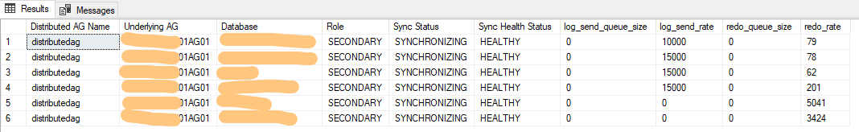
Monitoring DistAG - TSQL - DistAG Performance
-- shows underlying performance of distributed AG
SELECT
ag.[name] AS [Distributed AG Name], ar.replica_server_name AS [Underlying AG],
dbs.[name] AS [Database], ars.role_desc AS [Role],
drs.synchronization_state_desc AS [Sync Status],
drs.synchronization_health_desc AS [Sync Health Status],
drs.log_send_queue_size, drs.log_send_rate,
drs.redo_queue_size, drs.redo_rate
FROM sys.databases AS dbs
INNER JOIN sys.dm_hadr_database_replica_states AS drs ON dbs.database_id = drs.database_id
INNER JOIN sys.availability_groups AS ag ON drs.group_id = ag.group_id
INNER JOIN sys.dm_hadr_availability_replica_states AS ars ON ars.replica_id = drs.replica_id
INNER JOIN sys.availability_replicas AS ar ON ar.replica_id = ars.replica_id
WHERE ag.is_distributed = 1
ORDER BY dbs.name, ag.name, ar.replica_server_name

Slide 26
Monitoring DistAG - TSQL - All DB Performance
-- displays sync status, send rate, and redo rate of availability groups, including distributed AG
SELECT
ag.name AS 'AG Name', ag.is_distributed,
ar.replica_server_name AS 'AG', dbs.name AS 'Database',
ars.role_desc, drs.synchronization_state_desc,
drs.synchronization_health_desc, drs.log_send_queue_size,
drs.log_send_rate, drs.redo_queue_size, drs.redo_rate,
drs.suspend_reason_desc, drs.last_hardened_lsn,
CASE WHEN MIN(drs.last_hardened_lsn) OVER(PARTITION BY dbs.name) = MAX(drs.last_hardened_lsn) OVER(PARTITION BY dbs.name) THEN 'Y' ELSE 'N' END AS lsn_match,
drs.last_sent_time, drs.last_received_time, drs.last_hardened_time,
drs.last_redone_time, drs.last_commit_time,
DATEDIFF(SECOND, [drs].[last_commit_time], MAX(CASE WHEN [drs].[is_primary_replica] = 1 THEN [drs].[last_commit_time] END) OVER(PARTITION BY [drs].[group_id], [drs].[database_id])) AS [estimated_recovery_time],
CONVERT(varchar, DATEDIFF(SECOND, [drs].[last_commit_time], MAX(CASE WHEN [drs].[is_primary_replica] = 1 THEN [drs].[last_commit_time] END) OVER(PARTITION BY [drs].[group_id], [drs].[database_id])) / (60*60*24)) + '.'
+ CONVERT(varchar, DATEADD(SECOND, DATEDIFF(SECOND, [drs].[last_commit_time], MAX(CASE WHEN [drs].[is_primary_replica] = 1 THEN [drs].[last_commit_time] END) OVER(PARTITION BY [drs].[group_id], [drs].[database_id])), CONVERT(datetime, '00:00:00', 108)), 108) AS [secondary_lag_commit_time],
[drs].[secondary_lag_seconds],
([drs].[log_send_queue_size] / ISNULL(NULLIF([drs].[log_send_rate], 0), 1)) + (([drs].[log_send_queue_size] + [drs].[redo_queue_size]) / ISNULL(NULLIF([drs].[redo_rate], 0), 1)) AS [secondary_lag_seconds_log_send_redo],
CONVERT(varchar, DATEADD(SECOND, ([drs].[log_send_queue_size] / ISNULL(NULLIF([drs].[log_send_rate], 0), 1)) + (([drs].[log_send_queue_size] + [drs].[redo_queue_size]) / ISNULL(NULLIF([drs].[redo_rate], 0), 1)), CONVERT(datetime, '00:00:00', 108)), 108) AS [secondary_redo_eta]
FROM sys.databases dbs
INNER JOIN sys.dm_hadr_database_replica_states drs ON dbs.database_id = drs.database_id
INNER JOIN sys.availability_groups ag ON drs.group_id = ag.group_id
INNER JOIN sys.dm_hadr_availability_replica_states ars ON ars.replica_id = drs.replica_id
INNER JOIN sys.availability_replicas ar ON ar.replica_id = ars.replica_id
ORDER BY dbs.name, ag.name, ar.replica_server_name
GO

Slide 27
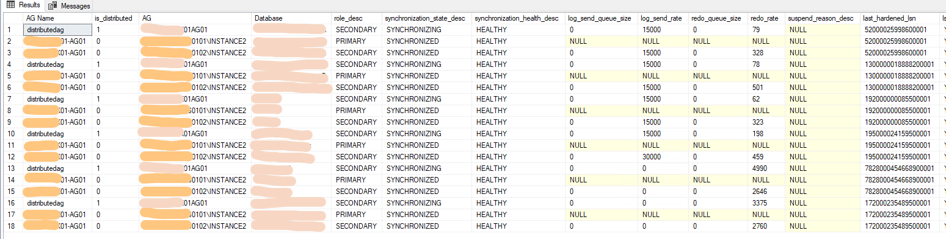

Slide 28
Monitoring DistAG - TSQL - Endpoints
-- shows endpoint url and sync state for ag, and dag
SELECT
ag.name AS group_name,
ag.is_distributed,
ar.replica_server_name AS replica_name,
ar.endpoint_url,
ar.availability_mode_desc,
ar.failover_mode_desc,
ar.primary_role_allow_connections_desc AS allow_connections_primary,
ar.secondary_role_allow_connections_desc AS allow_connections_secondary,
ar.seeding_mode_desc AS seeding_mode
FROM sys.availability_replicas AS ar
JOIN sys.availability_groups AS ag ON ar.group_id = ag.group_id
ORDER BY ag.name, ar.replica_server_name

Slide 29
Source Code

Slide 30
Diving a Little Deeper...

Slide 31
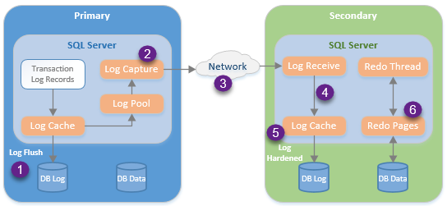
How AGs Work Behind the Scenes
https://www.sqlshack.com/measuring-availability-group-synchronization-lag/

Slide 32
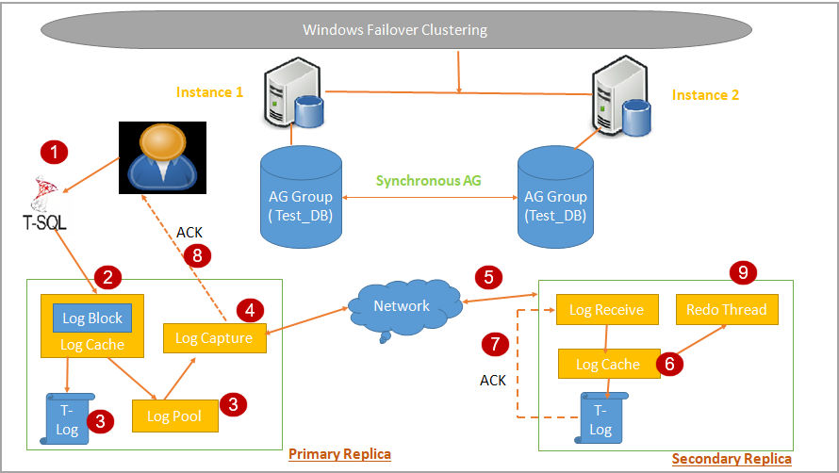
Synchronous Commit
https://www.sqlshack.com/data-synchronization-in-sql-server-always-on-availability-groups/

Slide 33
Synchronous Commit
Let’s follow a transaction from start to finish!
User performs some DML (or DDL!) action
Tran log records to cache in primary
Logs flushed to disk and copied to Log Pool
Logs sent to secondary replica(s)
Secondary writes log to cache
Transaction ‘redone’ on secondary
Flushed to log (hardened) on secondary
Sends acknowledgement to primary
Primary sends completion to client (transaction committed)

Slide 34
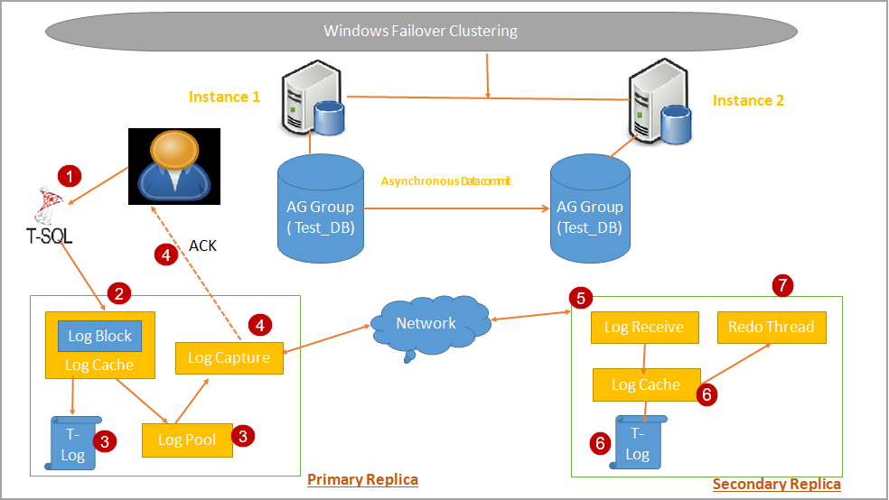
Asynchronous Commit
https://www.sqlshack.com/data-synchronization-in-sql-server-always-on-availability-groups/

Slide 35
Asynchronous Commit
Let’s follow a transaction from start to finish!
User performs some DML (or DDL!) action
Tran log records to cache in primary
Logs flushed to disk and copied to Log Pool
Primary sends completion to client (transaction committed)
Logs sent to secondary replica(s)
Secondary writes log to cache
Transaction ‘redone’ on secondary
Flushed to log (hardened) on secondary
Could be *some latency between primary and async secondary

Slide 36
So What Happens When a Sync Replica Isn’t Syncing?
Primary will still work!
Temporarily treated as asynchronous (users don’t notice any difference)
Transactions will be committed
Log entries retained until secondary comes online
TLog will GROW
Once secondary is online, logs sent and redone
Beyond a certain point (log files too big, or latency too high to catch up), it might be better to remove DB from AG and reseed once issue has been resolved (from fresh backup)

Slide 37
References

Slide 38
References
https://docs.microsoft.com/en-us/sql/database-engine/availability-groups/windows/prereqs-restrictions-recommendations-always-on-availability?view=sql-server-ver15
https://docs.microsoft.com/en-us/sql/database-engine/availability-groups/windows/always-on-availability-groups-sql-server?view=sql-server-ver15
https://docs.microsoft.com/en-us/sql/database-engine/availability-groups/windows/overview-of-always-on-availability-groups-sql-server?view=sql-server-ver15
https://www.brentozar.com/sql/sql-server-alwayson-availability-groups/
https://docs.microsoft.com/en-us/sql/database-engine/availability-groups/windows/distributed-availability-groups?view=sql-server-ver15
https://docs.microsoft.com/en-us/sql/database-engine/availability-groups/windows/distributed-availability-groups?view=sql-server-ver15

Slide 39

SQL Server Availability Groups
I’ve placed all of my favourite AG-related queries in this github repo:
https://github.com/AngelaKru/SQLServerAG
Angela Kruger
@AngelaRossInnes https://twitter.com/angelarossinnes
sqlmarathons@gmail.com
https://www.linkedin.com/in/angela-kruger-a108752a/

